Slide 1

Threading and Perl – avoiding insanity and managing the clones effectively
YAPC::NA 2014
- David Bury
Notes:
Walkthrough
when to use threads, how to manage them, and a quick example. 20 minutes.

Slide 2


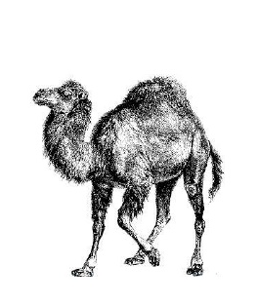
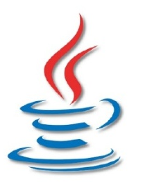

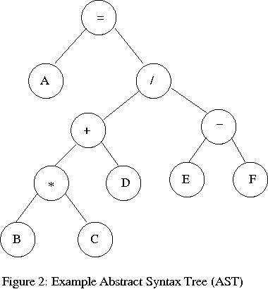

About Me?
Live in Monterey, CA (moving to San Diego, CA)
About 10 years in software
Recently back/forth Perl and Java.
Lots of focus on data back ends and sets.
Enjoy playing with a parser or two
Moving to mess around with big data problems.
First YAPC::NA presentation
dsbike@gmail.com for contact.
2

Slide 3

Why Use Threads?
A normal, single threaded, program is unusable
A client UI – Can’t do graphics and work and be usable.
Performance and use of CPU matters
Normal program uses one core out of many.
Matters with 4, 16, 32 cores. Cores increasing.
High latency Operations
Cost is in wait time, sequential waits are slow.
Parallel waiting faster and better design.
3
Notes:
Before you use threads, you need to make the case for them:
need for at least two things to happen at once. For example a GUI + takes minutes can’t be run in a single thread.
CPU bound applications + performance
¼ of a quad core processor … 16, 32 or more?
multithreading to utilize
High latency applications also needs threads to work optimally.
waiting or basic setup.
one at a time or wait all at once?
Threads=faster and wait less.

Slide 4

The Catch
Normal Code
+
Threads
=
Pandemonium
All Potential Normal linear code problems
Non-deterministic behavior
linear code problems
X
Randomness
Simultaneous story lines
X
Story lines Emergent Behavior
Story line interactions
4
Notes:
potholes!
Normal problems +=
Non deterministic behavior or randomness of what/when/if
simultaneous stories
interactions of threads
conspire … pandemonium!
You have normal problems,
randomness – location problem occur, 1/10, 1/1000 explode.
Runtime - deadlocking, resource collisions, runaway process.
out of hand, tactics…

Slide 5
Controlling Emergent Behavior
Design of runtime interactions and multithreaded components matter. Use well defined design patterns.
Examples
Pattern | Summary
Barrier | No thread progress at certain points
Double-checked locking | Use a lock with a pre-lock to lock better
Reactor | Event based concurrent execution
Reader-writer lock | Alternation of read/write locking
Thread Pool | Queue based distribution of work
5
Notes:
Runtime problems; hard analyze = concurrent design patterns
Understand clone parts/normal parts… application needs to the pattern
Barrier – kind of like checkpointing; you always know at specific points where things area.
Double-checked locking – like normal file based locking except to an extra check to lower locking costs
Reactor – this can be a dangerous pattern but is basically an event system with threads.
Reader-writer lock – This is an optimization based on read/write needs, I don’t fully understand this one.
Thread Pool –favorite, it’s a queue of work that gets sent to N set number of processors or the Pool.
Other patterns as well.

Slide 6
The Thread Pool
New Task
Queue – Contains ordered list of Tasks to complete:
Task 1
Task 2
Task 3
Task 4
Task 5
Task N
Task Sent
Pool – Contains N Threads that process concurrently:
Worker 1
Worker 2
Worker 3
Worker N
Like having one line of customers at a grocery store for checkout; each person goes to the first free N cashiers. Customer = task, cashiers = pool.
6
Notes:
thread pool pattern.
new tasks -> Queue, ; newest tasks -> pool
The pool contains N threads. Pull to keep full
Bank line/teller/bank
workers = dumber + simple
Single = housekeeping / logic

Slide 7
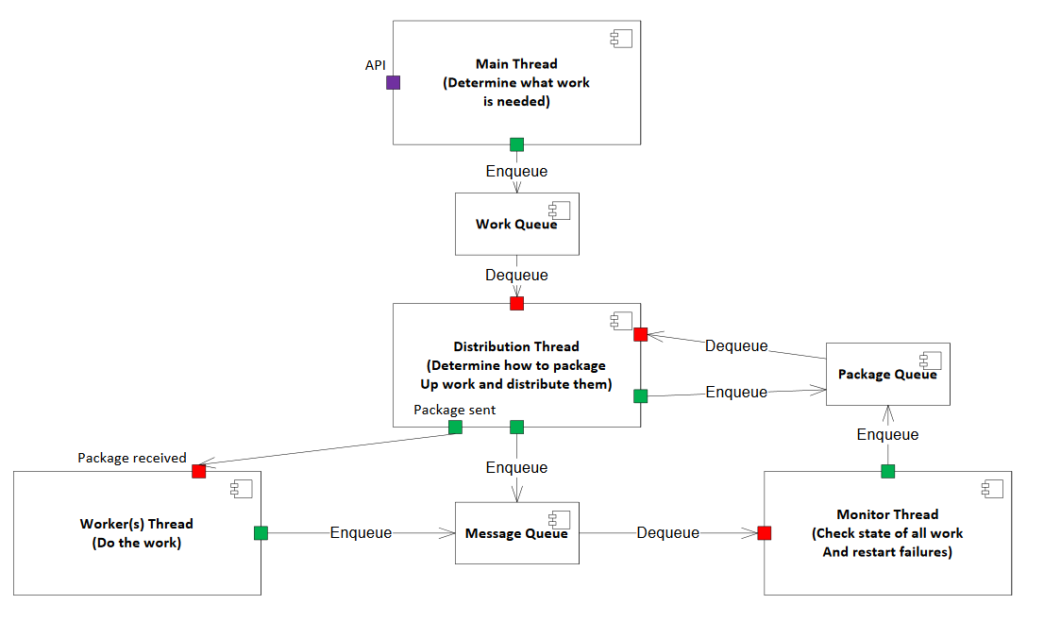
Thread Pool Example
7
Notes:
Real example
Detail later; overview
Thread::Queue - inter-process communication.
A single thread figure outs what work needs to be done to send to a distribution thread.
This distribution thread packages the work into good sizes and sends these to the thread pool.
Worker process does work tells monitor progress.
A monitor thread checks state and records success and can resend failed packages.
Next, Perl specific thread creation…

Slide 8
Perl Threads 101
“use threads”
“threads->create(‘function_name’, arguments)”
Runs in a new thread function_name with your arguments.
Argument Pitfalls:
Not completely normal function call
More than one level in hash or array = missing data in thread.
Complex data needs threads::shared (next slide)
8
Notes:
To use threads:
You import the threads module
Then run the create function to execute your function with the arguments you want.
-- rough overview – Not too bad, well its not like it seems:
It’s not exactly a function call, you can’t do everything like in a call but a lot.
When dealing with array or hashes that go beyond just one level of depth, you’ll find data disappearing in threads (+ confusion)
You need to be careful how you pass data structures that are complex, you’ll need threads::shared… which is our next slide.

Slide 9

threads::shared 101
“use threads::shared”, only after “use threads”
Basic use
“my $var :shared”
“{ lock($var); # read/write}”
Limitations
Only works on scalars, arrays, hashes, + refs.
No glob, code ref support.
Caution on array of array, hash of hash
“share_clone($data)” helps but copies values not references.
9
Notes:
Import in order
Variables shared between threads. You’ll want this in most applications.
basic define with “:shared”. First or data lost.
Lock or else … reading + writing.
no Unlock function as early as possible. Wrap in blocks
X share - globs + code references. Whole class … can fail … some where some dependency in the object uses a blob or other illegal structure.
complex - use share_clone like here.
copies VALUES not REFERENCES; data changes do not propagate.

Slide 10

Communication between Threads
Basic
Locks with threads::shared – tracking/coordination variable(s) of simple state.
Semaphores
The thread safe count – 0/1 like a basic locking, counter for resource sharing.
Other
Thread::Queue – Queues that are thread safe.
10
Notes:
talk between threads.
basic -shared data structure. scalar for some value; single level hash or array.
Pass in threads->create method or package variables
Use simple coordination.
Semaphores …handle its locking automatically.
0/1 or binary versions for simple locking
counting version for resource sharing; 4 writes in threads 4 drives
Thread::Queue classic queue with thread stuff handled.
Passing objects like Work or Message …share data and messages between threads. No illegal things in the objects…
now Thread::Queue…

Slide 11

Thread::Queue
Works very nicely with Thread Pool pattern.
Have multiple threads write to this: state/work
Have one responsible thread read/distribute.
“my $queue = Thread::Queue->new()”
Pass queue object freely to threads (as param)
Write to queue: “$queue->enqueue($data)”
Read off queue
“$queue->dequeue_timed($seconds, $number_wanted)”
11
Notes:
Airport queue
Works well with the thread pool pattern giving a nice easy interface to queues while handing the details on threading for you.
Many threads can write to the queue and one (preferably) can read easily.
Basic usage is:
Create the object,
Share it among the threads that need to use is (threads->create param)
One of these threads (preferably) needs to read it.
I prefer the dequeue_timed function because I want it to give up after a while or after getting some number. So don’t hang or get too much data.

Slide 12




Testing with Threads
Mocking test classes usually depend on manipulating object in memory
Fails in most thread testing
Possible only on some object/function structures
Solution: Mock Statically – physically modify libs and files for testing.
Use test area of overriding libraries
Create mock of in memory object
Write object file to test area; Reload libraries
Run your test.
Advanced
Use file based variable set/get with static mocking
Handles changes to mock object behavior for variety of test scenarios.
12
Notes:
Testing!
Mocking good
many scenarios without actual sites/database/website
which takes time to set up and can disappear.
love mocking; memory magic in the mocking gets reset … the mock becomes the original class.
It might be possible with some object/function structures for that mocking but just maybe.
Mocking statically will make mocking work. heavy handed
Create a fake library area.
Build your fake in memory objects, write to the fake library
Make the fake library come before your normal perl path; reload the library.
Then, run your test.
Sometimes you need the mocks to change behavior during test or inside the test
simple file based variable system
super global variable for the testing.

Slide 13
Real life Example
Cmd_daemon
Runs threads to control sub-categories of actions
Database configuration/state
Categories Launched
Sub Cat1
Sub Cat2
Sub Cat3
Sub CatN
Master
Work Units
Distributor
Work Packages
Package Redo
Worker 1
Worker 2
Worker 3
Worker N
Package Sent
Work Package/State
Monitor
13
Notes:
Here’s what I have using lots of threads.
The Daemon executes, runs threads that handle each of the broad categories of work on the system
Each of these categories is running the diagram starting at master.
The master figures out what work to do and controls what the system does.
A queue links the master thread to the distributor thread where units of work are sent to be done. Small piece do in system
This distributor takes these units and packages these up into optimal size for processing or by some timeout in the thread pool. The distributor pushes ready packages to another queue. It then sends the packages to available worker threads for processing.
Each worker thread sends data to a monitor thread via another queue which lets the monitor figure out what succeeded or failed. The monitor can sent failed packages back into the distributor package queue to be resent to the thread pool (up to n times retry config). Also the Distributor send data to the monitor about what it tries for processing in order to detect hanged or fatal errors in the workers.
The daemon runs on a cluster of nodes coordinated via a database.

Slide 14

Conclusion
Use when needed only, non-trivial
Runtime logic especially critical to understand
Design pattern helpful for design or starting point
Simplicity in data sharing helps system management
Understand thread API and limitations with threads
Unit Test, Integration Test, Thread Test
14
Notes:
Threads take a lot of patience, planning, and headaches; use it only when you need its capabilities.
You need to pay a whole lot of attention to the run time aspects to determine what it actually does.
Design patterns help boil down the known patterns that we know work and should form a core of your design.
Simplicity in data sharing help simplify and make the code understandable and easier to debug.
Know that you’re using Perl threads and understand its special and needs more care.
Testing is really important to keep bugs lower than the pandemonium level. Bugs multiply fast especially with threads.

Slide 15
Thank You
Further Question/Comments: dsbike@gmail.com
15

